Slide 1

Employment Equity
Commencement of the Employment Equity Amendment Act, number 4 of 2022 (Gazette 12 November 2024) with 1 January 2025 effective date and Gazetted Regulations_15 April 2025
Facilitated by

Slide 2
Disclaimer
This presentation is provided by EECMS for informational purposes only and is intended to offer a general overview of the new Employment Equity Act.
The content does not constitute legal advice or a definitive interpretation of the Act. EECMS is not liable for any actions taken or decisions made based on the interpretation of the information presented.
For specific guidance, whether legal or for the clarification regarding the Employment Equity Act, please contact us for further consultation.

Slide 3
COMMENCEMENT OF THE EMPLOYMENT EQUITY AMENDMENT ACT, 2022
  Following sections came into operation on 1 January 2025
  Section 1 (Definitions).
  Section 8 (Psychometric testing).
  Section 14 (Voluntary compliance).
  Section 15A (Affirmative action measures).
  Section 16 (Consultation with employees).
  Section 20 (Employment equity plan – EE plan).
  Section 21 (Report).
  Section 27 (Income differentials).
  Section 36 (Undertaking to comply).
  Section 37 (Compliance order).
  Section 42 (Assessment of compliance).
  Section 53 (State contracts).
  Schedule 4 (Turnover thresholds)

Slide 4
COMMENCEMENT OF THE EMPLOYMENT EQUITY AMENDMENT ACT, 2022
Amendment of section 1 (definitions)
The following changes made to the definitions:
The definition of a designated employer is amended by repealing paragraph (b) which classifies employers with fewer than 50 employees who meet a turnover threshold as designated employers. Repealing Schedule 4.
A definition of the National Minimum Wage Commission is introduced (and it means the Commission established in terms of section 8 of the National Minimum Wage Act, 2018 (Act No 9 of 2018).
People with disabilities includes people who have a long term or recurring physical, mental, intellectual or sensory impairment which, in interaction with various barriers, may substantially limit their prospects of entry into, or advancement in, employment, and “persons with disabilities” has a corresponding meaning.
A definition of sector is included (sector means an industry or service or part of any industry or service) – EEA17

Slide 5
COMMENCEMENT OF THE EMPLOYMENT EQUITY AMENDMENT ACT, 2022
Amendment of section 8 (Psychometric testing)
Psychological testing and other similar assessments of an employee are prohibited unless the test or assessment being used–
  (a) has been scientifically shown to be valid and reliable;
  (b) can be applied fairly to all employees; and
  (c) is not biased against any employer or group and will now also include
  (d) has been certified by the Health Professions Council of South Africa established by section 2 of the Health Professions Act, 1974 (Act 56 of 1974), or any other body which may be authorised by law to certify those tests or assessments.

Slide 6
COMMENCEMENT OF THE EMPLOYMENT EQUITY AMENDMENT ACT, 2022
Amendment of section 14 (Voluntary compliance)
Employer that is non-designated may request the DG to voluntary comply is now repealed.
Insertion of new section 15A (Affirmative action measures)
A new section, 15A, is inserted allowing the Minister to –
  Identify national economic sectors for the purposes of the administration of the Employment Equity Act;
  Set numerical targets for these sectors (after consulting the relevant sectors and with the advice of the Commission).
  The sectoral targets set may differentiate between occupational levels, sub-sectors, regions or other relevant factors.
  The Minister may publish a draft of any notice in the Gazette, allowing interested parties at least 30 days to comment thereon.

Slide 7
COMMENCEMENT OF THE EMPLOYMENT EQUITY AMENDMENT ACT, 2022
Amendment of section 16 (Consultation with employees)
A designated employer must take reasonable steps to consult and attempt to reach agreement on the matters referred to in section 17 (drafting, implementation and monitoring of the EAP analysis, sectoral numerical targets, EE plan, employment barriers and EEA2 reporting) with
1. A representative trade union representing members at the workplace.
2. If no representative trade union represents members at the workplace, with its employees or representatives nominated by them.
Our interpretation:
Companies with a representative trade union will need to consult with the representative trade union.
If no representative trade union, normal process of EE committee meetings at least quarterly to discuss the above mentioned – Need to comply with the constituency of the EEC.

Slide 8
COMMENCEMENT OF THE EMPLOYMENT EQUITY AMENDMENT ACT, 2022
Section 20 (Employment equity plan – EE plan)
Numerical goals (objectives as at end date of EE plan) set by an employer must comply with any sectoral target in terms of section 15A applicable to that employer.
Section 15A – Sectoral numerical targets set April 2025.
Question: What is the possible impact on our company?
  EE Plan - Employers will need to set EE targets aligned to the sectoral numerical targets. Thus; new EE Plan, commencement date 1 September 2025 (5-year EE Plan).
  EE plan to be monitored against sectoral numerical targets every year as part of the compliance certification process by applicable stakeholder(s).

Slide 9
COMMENCEMENT OF THE EMPLOYMENT EQUITY AMENDMENT ACT, 2022
Section 21 (Reporting)
A designated employer must submit a report to the DG once every year on such date and in such manner as prescribed.
An employer that cannot submit a report to the DG within the period prescribed must notify the DG in the prescribed manner and period giving reasons for its inability to do so.
Section 27 (Income differentials)
Section 27 is amended to transfer the functions of the Employment Conditions Commission in respect of reporting and monitoring of disproportionate income differentials to the National Minimum Wage Commission.

Slide 10
COMMENCEMENT OF THE EMPLOYMENT EQUITY AMENDMENT ACT, 2022
Section 36 (Undertaking to comply)
A Labour Inspector must request and undertake a written undertaking to comply with section 20 (EE plan), if the Inspector has reasonable grounds to believe that the employer has failed to comply.
Section 37 (Compliance order)
Section 37 is amended to permit the Minister to prescribe by regulation the manner of service of compliance orders on employers.
Section 42 (Assessment of compliance)
In determining whether the designated employer is in compliance with this Act, the DG or any person or body applying this Act, must take into account whether the employer has complied with the sectoral numerical targets as set out in terms of section 15A applicable to that employer.

Slide 11
COMMENCEMENT OF THE EMPLOYMENT EQUITY AMENDMENT ACT, 2022
Section 53 (State contracts)
Section 53 provided that State contracts may only be issued to employers that have been certified as being in compliance with their obligations under the Employment Equity Act.
Subsection (1) is amended to require that an employer attaches a certificate when concluding a contract with the State in terms of Subsection (2) as conclusive evidence that the employer complies with the relevant Chapters of the Act.
A new section 53(6) is inserted to clarify that the Minister of Employment and Labour may only issue a certificate to an employer if the Minister is satisfied that the employer–
  has complied with the sectoral numerical targets set in terms of section 15A applicable to that employer, or has raised a reasonable ground for non-compliance;
  has submitted its most recent employment equity reports and
  has not been found within the previous twelve months to have breached the prohibition on unfair discrimination (CCMA) or to have paid wages below the level of the national minimum wage in the previous 12 months.

Slide 12
COMMENCEMENT OF THE EMPLOYMENT EQUITY AMENDMENT ACT, 2022
  Schedule 4 (Turnover thresholds)
  Repealed.
  IMPORTANT NOTE:
  Section 61 (Obstruction, undue influence and fraud)
  Important to note as per the current EE Act.
  No employer may knowingly take any measure to avoid becoming a designated employer.

Slide 13
Overview - EE Act, Regulations and Codes of Good Practise
Process Flow:
The EE Amendment Act (1 January 2025)
Two sets of regulations (15 April 2025)
  General Administrative EE regulations and
  Sectoral numerical targets regulations.
Codes of Good Practise (Latest = current).

Slide 14
General Administrative EE Regulations
ARRANGEMENT OF REGULATIONS
Definitions
WORK OF EQUAL VALUE
Equal Pay for Work of Equal Value Criteria
Eliminating unfair discrimination
Meaning of work of equal value
Methodology
Assessing whether work is of equal value
Factors justifying differentiation in terms and conditions of employment
DUTIES OF A DESIGNATED EMPLOYER
Collecting information and conducting an analysis
Duty to prepare and implement an Employment Equity Plan
Duty to report
Duty to inform
Income differentials and discrimination
ENFORCEMENT MECHANISMS
Requesting an undertaking
Compliance order
14A Service of compliance order
Review by the Director-General (DG Review)
GENERAL ADMINISTRATIVE MATTERS
EE Compliance Certificate in terms of section 53
Withdrawal of the EE Compliance Certificate (EEA 16C)
Repeal of laws
Short Title
Focus points for discussion today

Slide 15
General Administrative EE Regulations
FORMS AND ANNEXURES
EEA1: Employee declaration in terms of Section 19(1) of the Act.
EEA2: Report to the Director-General in terms of Section 21 of the Act.
EEA3: Summary of the Act in terms of Section 25(1) of the Act.
EEA4: Statement of income differentials in terms of Section 27 of the Act.
EEA5: Request for an undertaking in terms of Section 36 of the Act.
EEA6: Compliance order in terms of Section 37(1) of the Act.
EEA7: DG Review Assessment Form in terms of Section 43 of the Act.
EEA8: Demographic Data in terms of Section 42 of the Act.
EEA9: Occupational Levels in terms of Section 21 of the Act.
EEA10: Summary of the EE progress report in terms of Section 22 of the Act.
EEA11: Request for employer’s EE report in terms of Section 21(6) of the Act.
EEA12: Template for reporting on analysis conducted in terms of Section 19.
EEA 13: Template for EE Plan in terms of Section 20 of the Act.
EEA 14: Director-General Notification in terms of Section 21(4A) of the Act.
EEA 15: Request for an EE Compliance Certificate.
EEA 16A: EE Compliance Certificate for designated employers.
EEA 16B: EE Compliance Certificate for non-designated employers.
EEA 16C: Intention to withdraw EE Compliance Certificate.
EEA 16D: Withdrawal of EE Compliance Certificate.
EEA 17: Economic Sectors and Sub-Sectors.

Slide 16
General Administrative EE Regulations
  Collecting information and conducting an analysis
  Each employee to complete EEA1 (employee declaration form).
  Should employee refuse to complete or provide inaccurate information, employer may establish designation by using historical and existing data (and persons with disabilities have the right not to declare their disability).
  Designated employer must conduct an EAP Analysis and the outcome must be reported by using the EEA12 of these regulations.
  Designated employer must refer to relevant Codes of Good Practise (issued in terms of Section 54 of the Act) as a guide when collecting information and conducting the analysis (EEA12).
  When the designated employer designs the analysis, the employer may refer to:
      EEA8 (national and regional EAP) and
      EEA9 (Description of Occupational Levels).
  A designated employer must record on the EEA12 template whether it is using the national or regional EAP as a basis for conducting its analysis in terms of section 19 of the Act.

Slide 17
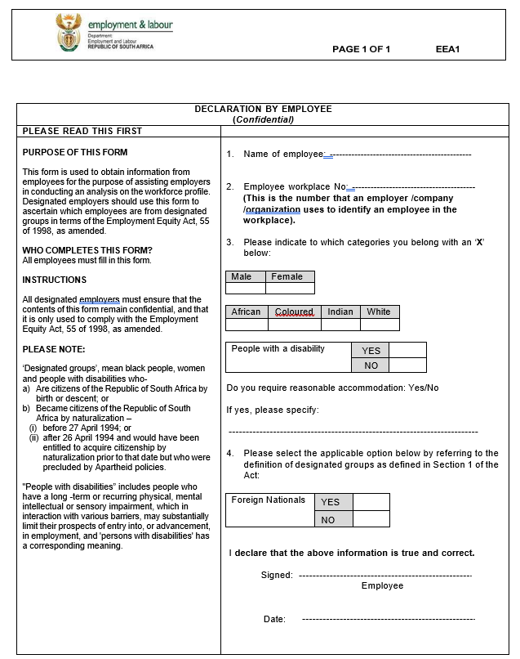
General Administrative EE Regulations

Slide 18
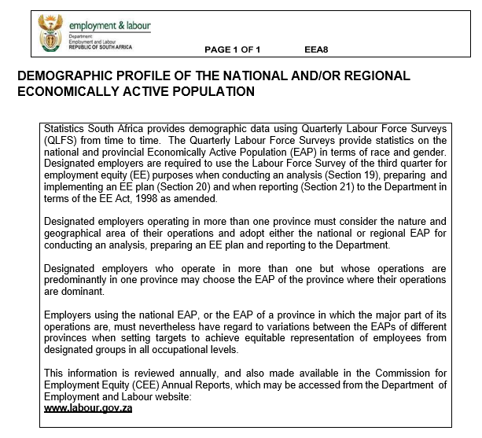
General Administrative EE Regulations

Slide 19
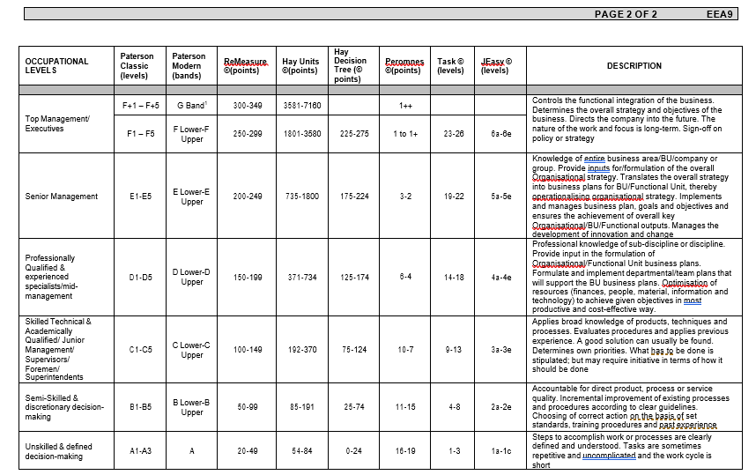
General Administrative EE Regulations

Slide 20
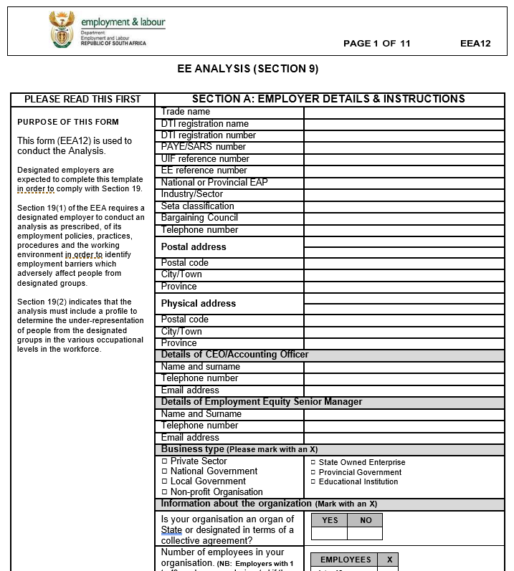
General Administrative EE Regulations
Collecting information and conducting an analysis…continued

Slide 21
General Administrative EE Regulations
  Duty to prepare and implement an EE Plan
  Designated employers must prepare and implement an EE Plan for the period from 1 September 2025 until 31 August 2030.
  Employers who become designated employers, after 1 April 2025, must prepare an EE Plan for the remainder of the period until 31 August 2030.
  A designated employer must refer to the relevant Codes of Good Practice issued in terms of section 54 of the Act when preparing an EE Plan.
  The EE Plan must contain, at a minimum, all the elements contained in the EEA13 template of these regulations.
  When developing EE Plans and setting annual numerical targets in their workplaces, designated employers must take into account:
    their workforce profile.
    the relevant 5-year sectoral numerical targets and
    the applicable EAP.

Slide 22
General Administrative EE Regulations
  Duty to prepare and implement an EE Plan…continued
  A designated employer may take into account any of the following to the extent that they are consistent with the purpose of the Act.
    the inherent requirements of a particular job.
    the pool of suitably qualified persons.
    the formal qualifications, prior learning, relevant experience or capacity to acquire, within a reasonable time, the ability to do the job, as contemplated in sections 20(3) to (5) of the Act.
    the rate of turnover and natural attrition within the workplace and
    recruitment and promotional trends within a workplace.
  A designated employer must:
    comply with the numerical targets set in terms of section 15A(3) for the economic sector in which they operate;
    refer to the Ministerial notice issued in terms of section 15A and EEA17 to the regulations to determine the sector they operate in and
    if it operates in more than one sector, apply the numerical targets for the sector in which the majority of their employees are engaged.

Slide 23
General Administrative EE Regulations
  Duty to prepare and implement an EE Plan…continued
  The 5-year sectoral numerical targets set in terms of section 15A(2) of the Act are key milestones towards achieving the equitable representation of the different designated groups within the four upper occupational levels in an employer’s workforce in relation to the demographics of the applicable EAP, and for persons with disabilities
  When determining their annual EE targets towards achieving the 5-year sectoral numerical targets, a designated employer must set numerical targets for all designated groups in each of the four upper occupational levels in relation to the applicable sector targets and EAP, and for persons with disabilities
  A designated employer must avoid perpetuating the over-representation of any group if their representation exceeds the applicable EAP in a particular occupational level
  A designated employer that has exceeded the numerical target set for a particular designated group at an occupational level should continue to set targets that maintain compliance with the EAP.

Slide 24
General Administrative EE Regulations
  Duty to prepare and implement an EE Plan…continued
  Designated employers must set numerical goals and annual EE targets at the semi-skilled and unskilled occupational levels based on EAP.
  Designated employers’ compliance will be assessed against their annual targets set towards meeting the relevant 5-year sectoral numerical targets
  A designated employer will incur no penalty or any form of disadvantage if there are reasonable grounds to justify its failure to comply with any target. Justifiable reasons are:
    Insufficient recruitment opportunities.
    Insufficient promotion opportunities.
    Insufficient target individuals from designated groups with the relevant qualifications, skills and experience.
    CCMA / Court order.
    Transfer of business.
    Merger / Acquisition.
    Impact on business economic circumstances (will need to elaborate, example due to loadshedding, loss of contract, major retrenchments, etc.)
    A designated employer must retain their EE Plan for a period of five years after the expiry of the EE Plan and must refer to the EEA9 in the regulations for guidance on how to differentiate between the various occupational levels.

Slide 25
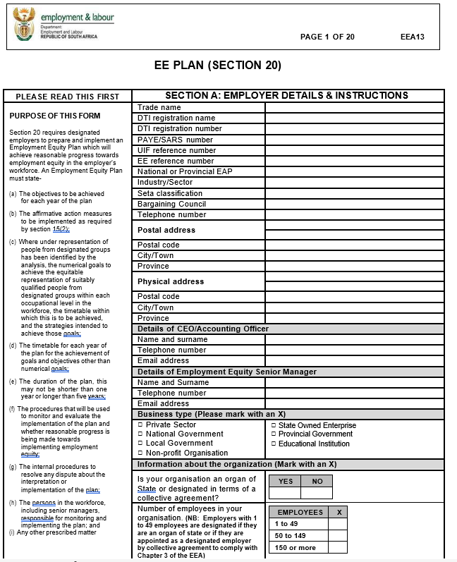
General Administrative EE Regulations
Duty to prepare and implement an EE Plan…continued

Slide 26
General Administrative EE Regulations
Duty to report (EEA2 and EEA4)
A designated employer must submit a report to the DG in terms of section 21 of the Act annually the EEA2 and EEA4 reports (preferably electronically between 1 September every year and 15 January the following year).
An employer that becomes a designated employer on or after the first working day of April is only required to submit its first report in the following reporting cycle.
A designated employer will not be assessed for compliance with its annual targets in the first report submitted after becoming a designated employer.
A designated employer may not be issued with a certificate in terms of section 53(2) of the Act unless it has submitted a compliant report in the preceding year.

Slide 27
General Administrative EE Regulations
Duty to report (EEA2 and EEA4)…continued
A designated employer that is a holding company controlling more than one registered entity may choose to submit a consolidated report, but must:
  Have a consolidated EE Plan, supported by individual EE Plan(s) for each registered entity within the consolidated EEA2 report.
  Adopt a method of reporting that remains consistent for the duration of the EE Plan.
A designated employer must retain a copy of the report for five years after it has been submitted.
Public companies that are designated employers must publish a summary of their EEA report as prescribed in the EEA10 template.
An EEA4 form submitted in terms of these Regulations is not a public document.

Slide 28
Determination of sectoral numerical targets Regulations
Implementation of AA measures
Effective date: Date of publication (15 April 2025).
The 5-year sectoral numerical targets are not intended to add to 100% as it excluded white males with no disabilities and foreign nationals as part of the workforce profile.
The manner in which designated employers must take the targets into account in applying AA measures is specified in:
  The Act (as amended 1 January 2025) – Sub races to be included (AM, CM, IM, AF, CF, IF and WF). “Align with the relevant EAP…”
  The General Admin EE Regulations (15 April 2025) and
  Codes of Good Practise issued under the Act (all current Codes).
A designated employer will incur no penalties or any form of disadvantage if (in the compliance analysis of AA in any workplace) there are justifiable / reasonable grounds for not complying with the targets.

Slide 29
Determination of Sectoral Numerical Targets Regulations
Economic Sectors (EEA17)
SECTORS
AGRICULTURE, FORESTRY & FISHING
MINING AND QUARRYING
MANUFACTURING
CONSTRUCTION
FINANCIAL AND INSURANCE ACTIVITIES
TRANSPORTATION AND STORAGE
INFORMATION AND COMMUNICATION
WATER SUPPLY, SEWERAGE, WASTE MANAGEMENT AND REMEDIATION ACTIVITIES
ELECTRICITY, GAS, STEAM AND AIR CONDITIONING SUPPLY
HUMAN HEALTH AND SOCIAL WORK ACTIVITIES

Slide 30
Determination of Sectoral Numerical Targets Regulations
Economic Sectors (EEA17)…continued
SECTORS
ARTS, ENTERTAINMENT AND RECREATION
REAL ESTATE ACTIVITIES
PROFESSIONAL, SCIENTIFIC AND TECHNICAL ACTIVITIES
WHOLESALE AND RETAIL TRADE; REPAIR OF MOTOR VEHICLES AND MOTORCYCLES
ACCOMODATION AND FOOD SERVICES ACTIVITIES
PUBLIC ADMINISTRATION AND DEFENSE; COMPULSORY SOCIAL SECURITY
EDUCATION
ADMINISTRATIVE AND SUPPORT ACTIVITIES

Slide 31
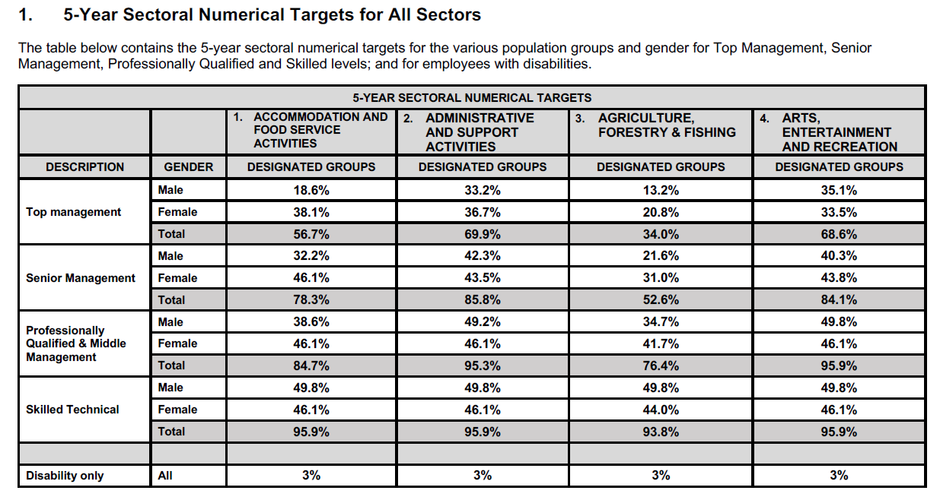
Regulations (5-Year sectoral numerical targets)

Slide 32
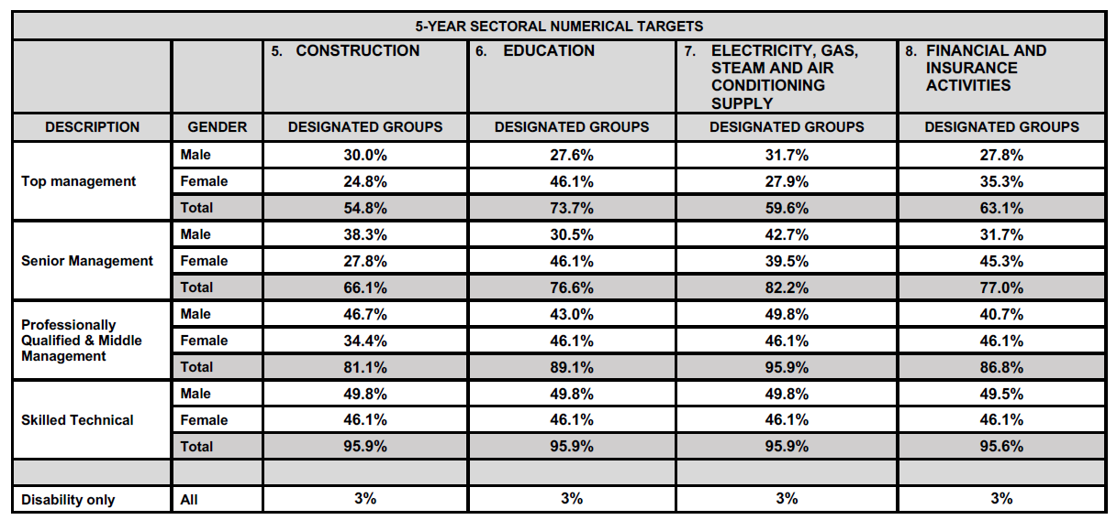
Regulations (5-Year sectoral numerical targets)

Slide 33
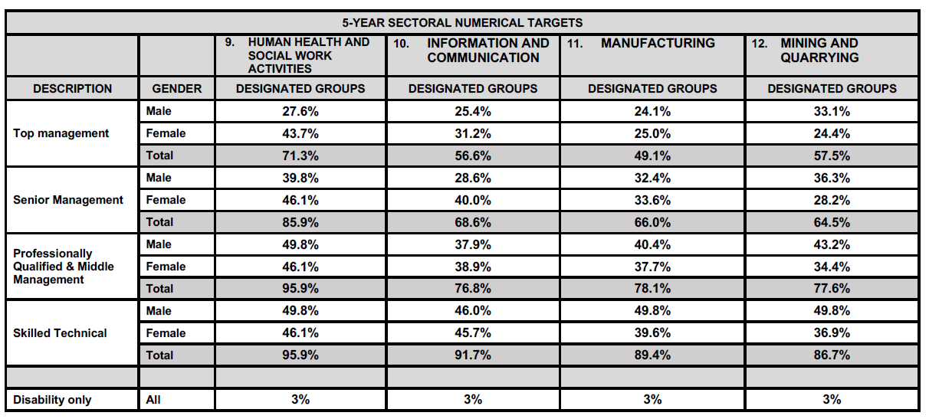
Regulations (5-Year sectoral numerical targets)

Slide 34
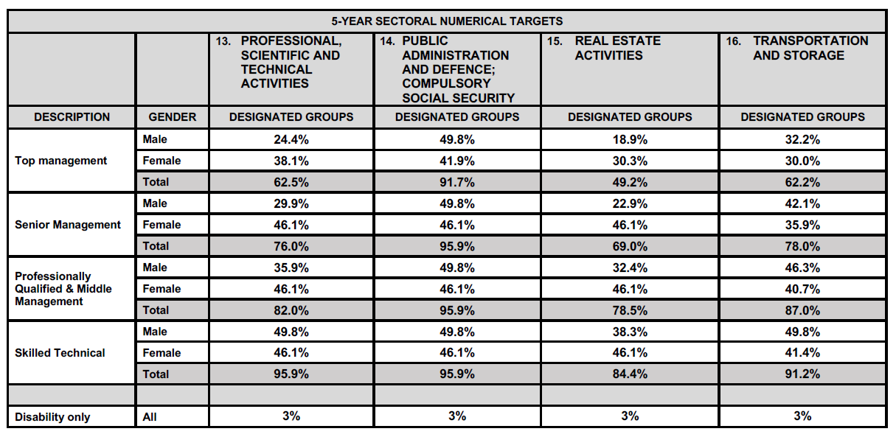
Regulations (5-Year sectoral numerical targets)

Slide 35
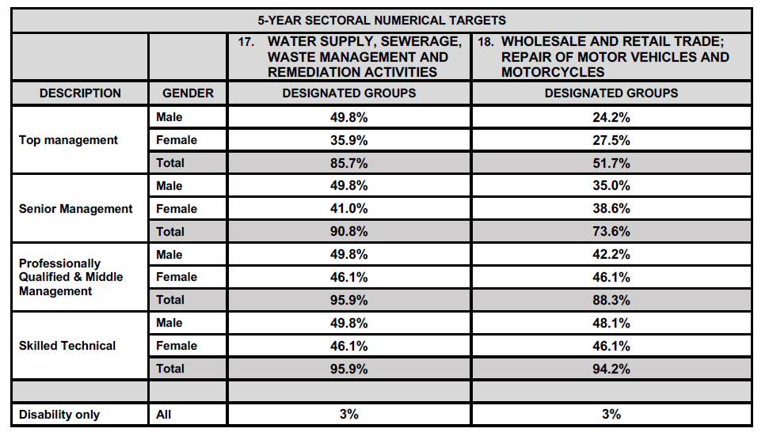
Regulations (5-Year sectoral numerical targets)

Slide 36
Regulations (5-Year sectoral numerical targets)
Repercussion for non-compliance
Penalties (starting at the greater of R 1 500 000.00 or 2% of annual turnover, up to the greater of R 2 700 000.00 or 10% of turnover).
Loss of Management & Control points (EE) on your BBBEE scorecard that could result in loss of BBBEE scorecard.
Loss of and / or no future State contracts.
Possible Reputational damage.

Slide 37
WHAT THIS MEANS FOR YOUR ORGANISATION
You must align your EE Plan to sectoral targets
You will be measured against annual targets
Compliance will be assessed against progress
Evidence and justifiable reasons will be critical

Slide 38
CURRENT LEGISLATIVE POSITION
Sectoral targets have been set, promulgated and gazetted.
Regulations have been set, promulgated and gazetted.
Employers deemed designated must implement EE Plans aligned to sectoral targets.
Employers deemed non-designated employers due to repeal of annual turnover thresholds must follow the applicable deregistration process.
Employers deemed non-designated employers due to repeal of annual turnover thresholds, (but requiring a BEE certificate or supplying products or services to the State) – must apply for and maintain compliance with the Section 16B certification process.

Slide 39
2025/2026 IMPLEMENTATION AND WAY FORWARD
(Year 1)
Implementation Focus
Plan and implement initiatives in line with Year 1 targets and projections of the organisation’s Employment Equity Plan.
Align recruitment, promotion, and development initiatives to achieve numerical goals.
Ensure active involvement of Top Management, HR, EE Manager(s), Line Managers, and Unions.

Slide 40
ROLE OF THE EMPLOYMENT EQUITY COMMITTEE
Monitor implementation of the Employment Equity Plan
Review progress against numerical targets
Identify barriers to equitable representation
Review deviations and justifications for non-achievement
Ensure effective consultation between the employer and employees on
employment equity matters

Slide 41
2025/2026 IMPLEMENTATION AND WAY FORWARD
(Year 1)
Monitoring & Compliance Focus
Conduct regular EE Committee meetings to monitor progress against
targets.
Continuously update, monitor, and maintain workforce movement data (recruitments, promotions, and terminations) to track progress against EE targets.
Identify and address barriers impacting equitable representation.
Maintain supporting evidence for compliance and non-achievement.
Document and substantiate justifiable reasons for non-achievement of targets.
Ensure consultation with the EE Committee / Unions, supported by
agendas, minutes, and signed registers of attendance.

Slide 42

THE END
EECMS would hereby like to thank you for your time.
Feel free to contact us for further queries.
CP du Toit (Pieter) SCAN QR CODE TO VISIT US
BComm. Fin. Acc.
Bcomm. (HONS) Internal Audit
079 847 1750
www.eecms.co.za

